Slide 1
Telecommunications Customer Churn Analysis
INSTRUCTOR：Dr. Ruoqing Zhu
GROUP MEMBERS: Xiaoying Yang, Bo Yang, Yvonne Ho

Slide 2
CONTENTS
INTRODUCTION
DATA WRANGLING
UNSUPERVISED LEARNING
SUPERVISED LEARNING
CONCLUSION AND DISCUSSION

Slide 3
INTRODUCTION

Slide 4
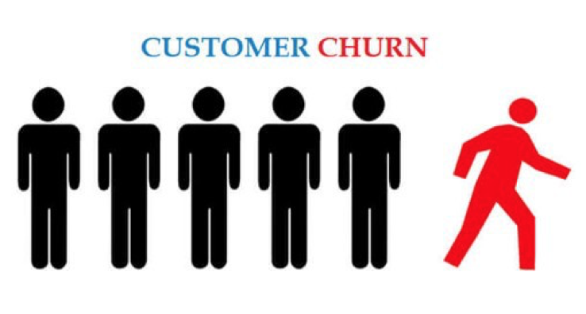
INTRODUCTION
CUSTOMER CHURN
Customer churn is a percentage of how many customers stopped using your company's product or service during a certain time frame.

Slide 5
INTRODUCTION
Ideas in Customer Churn Prediction
Predicting churn is to create proactive marketing campaigns targeted at the customers.
Forecasting customer churn with the help of machine learning is possible.
Machine learning and data analysis are powerful ways to identify and predict churn.
Churn is a one of the biggest problem in the telecom industry.
Research has shown that the average monthly churn rate among the top 4 wireless carriers in the US is 1.9% - 2%.

Slide 6
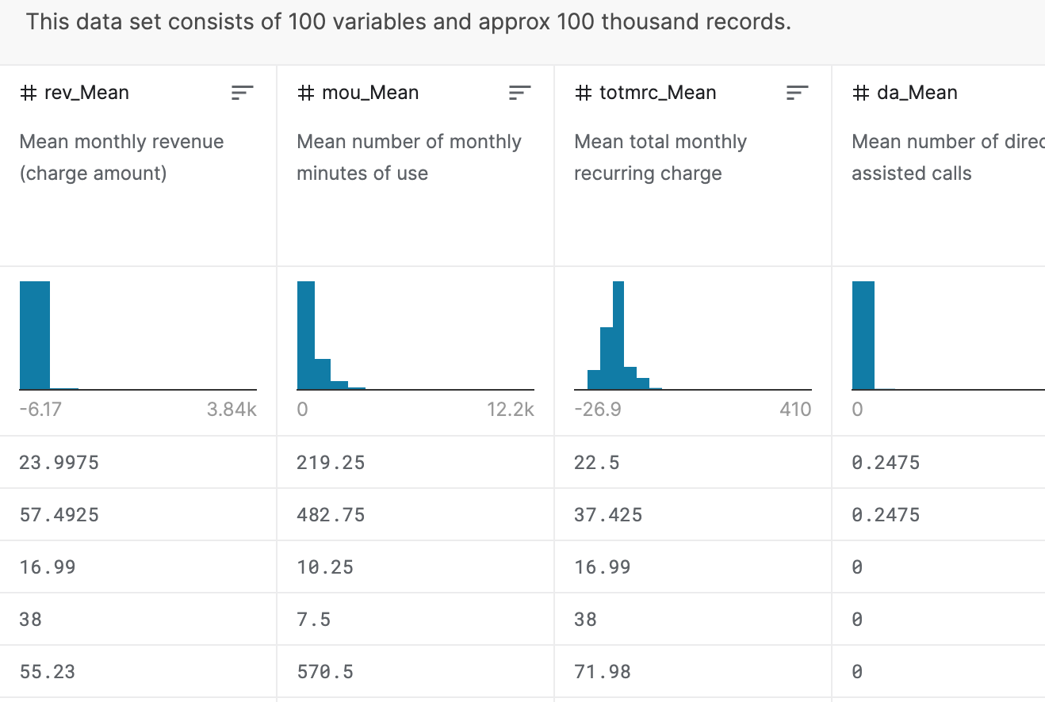
DATASET
Telecommunication customer churn analysis
This data set consists of 100 variables and approximates 100 thousand records.
The variables explain the attributes of telecommunications industry and various important customer factors.
Churn, the target variable, indicates whether the customer will keep using the products and services and can be predicted by associated variables.

Slide 7
TARGET
Identify if the churn variable (variable that characterizes the customers if they leave the telecom company or not) has any relationship with our analysis, and if we can classify the customers without using the churn variable and they correlate.
Select related variables and predict which characteristics of customers are most likely to lose and evaluate models.

Slide 8
METHODOLOGY
Data Cleaning
Feature Engineering
Variable Selection
Clustering
Model Prediction
Detected Missing Values
Used Random Forest to fill out the values
Check Correlations
Check outliers and scaling
Principal Component Analysis
Factor Analysis
Backward
Normal K-Means
Mahalanobis distance K-Means
Logistic Regression
Decision Tree
Random Forest
KNN

Slide 9
DATA WRANGLING

Slide 10
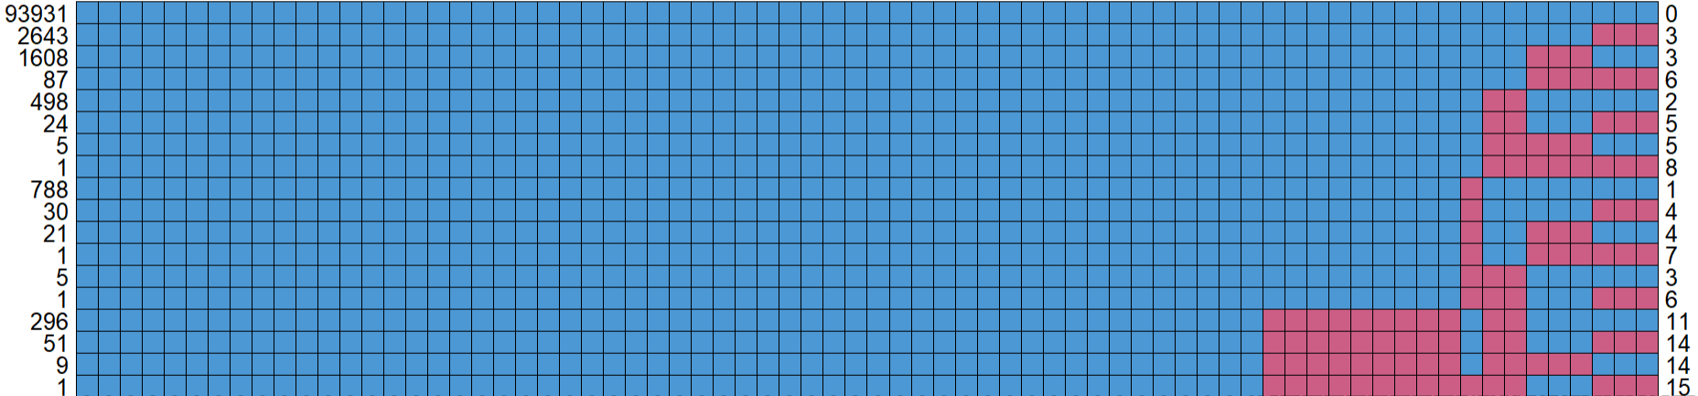
DATA WRANGLING
A total of 33 variables have missing values.
The variables with the most missing values are change_mou and change_rev, which have 891.

Slide 11
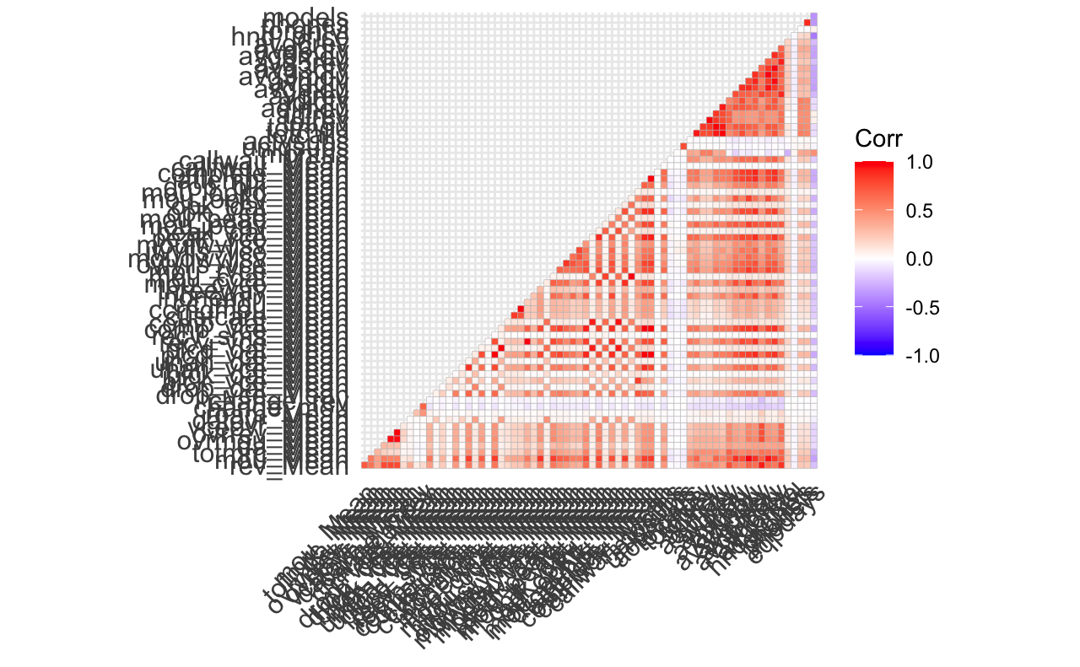
FEATURE ENGINEERING
Correlation between variables.
PCA can be applied.

Slide 12
UNSUPERVISED LEARNING

Slide 13
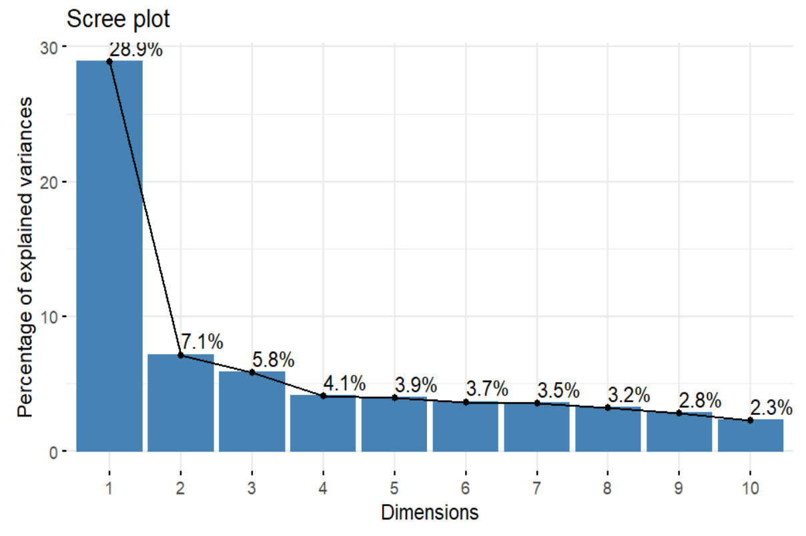
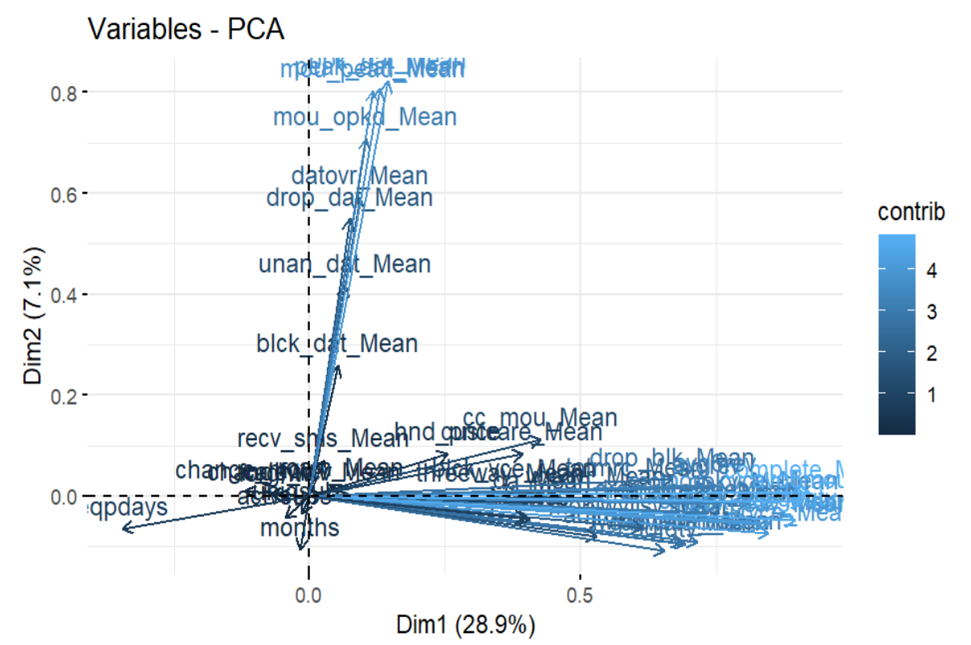
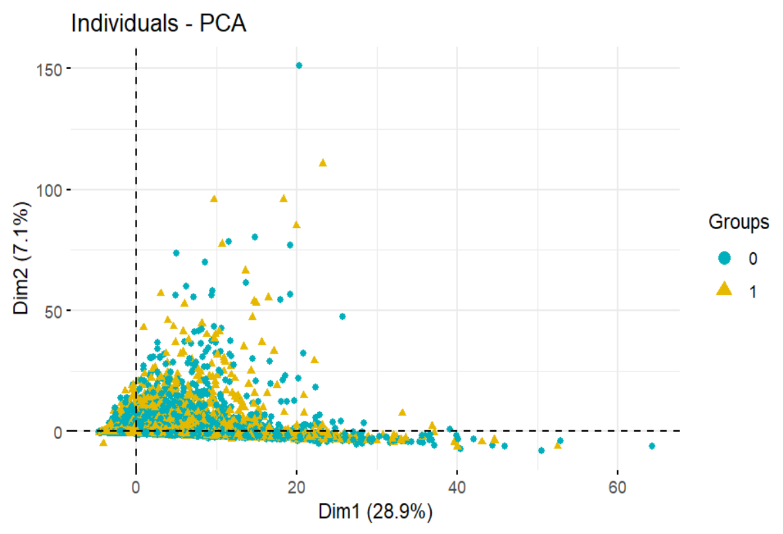
PRINCIPAL COMPONENT ANALYSIS
PCA analysis shows that the 1st principal component explains about 28% variance.
The first PC is dominated by 21 variables, which the biggest contribution is from variable named complete_mean.
The PC plot of 1st and 2nd dimension shows users who choose to retain cluster on the 1st PC axis, opposite situation occurs on the 2nd principal component axis.

Slide 14
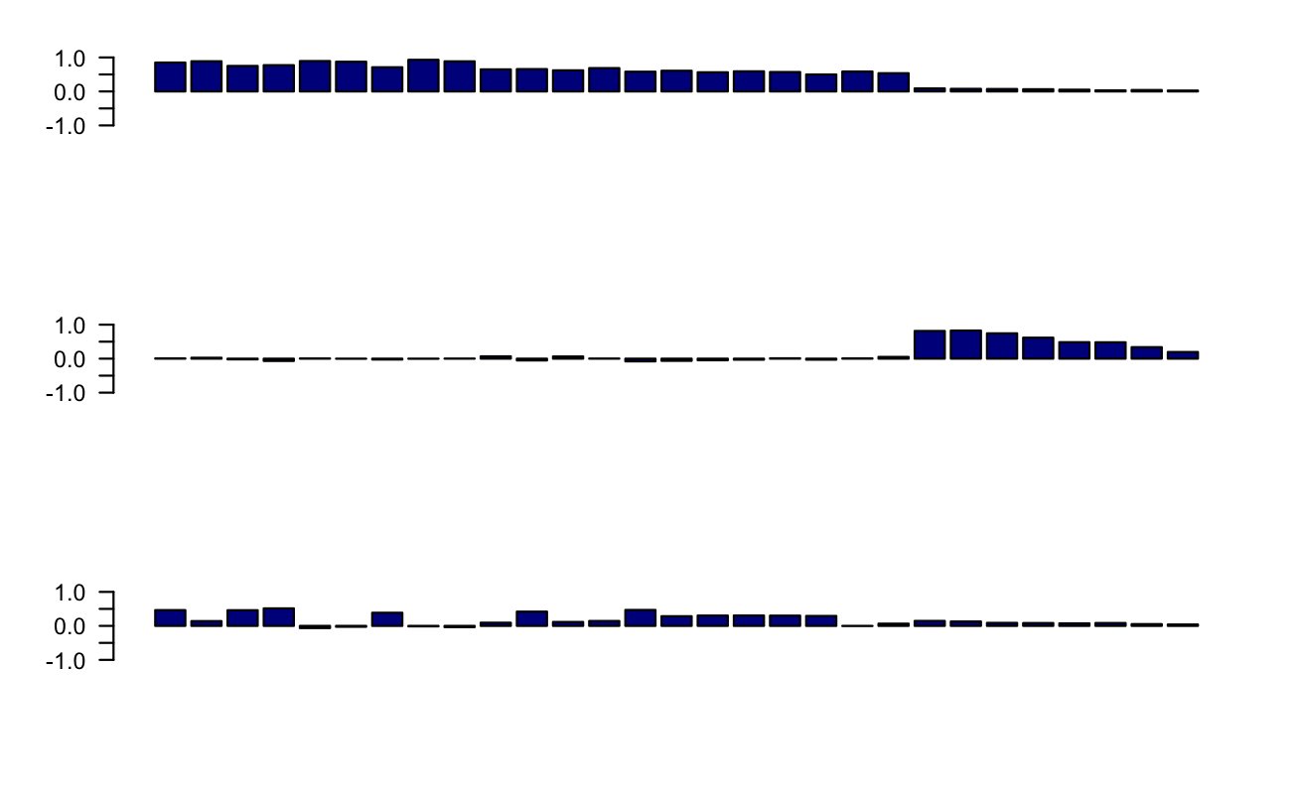
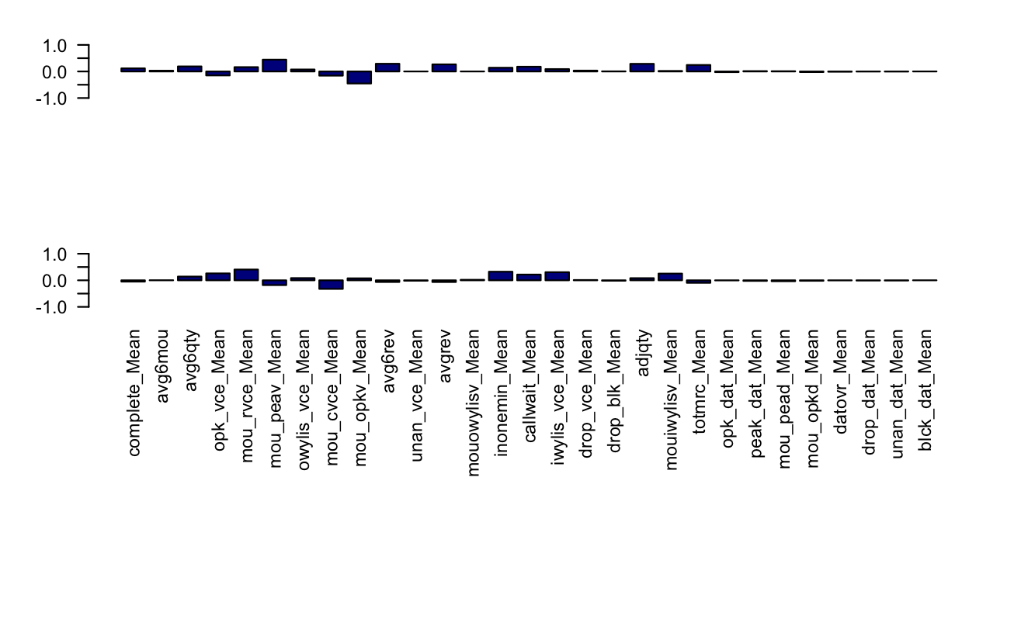
FACTOR ANALYSIS
Two of the factors show inverse correlations
They differ on the exact variables and show that the characteristics of the two type of customers are opposite.
First factor can be the customers that remain in the company, and the second factor the ones that leave the company
Notes:
Now let’s move on to the factor analysis and compare the results. Let's see if we can divide the customers and also if the results are similar to the PCA.
As the variables are too big for the factor analysis, we will reduce it. We use PCA with the most imporant variables of the first 3 PCs to reduce it. （We use the ones that are high enough, as my group member described in previous slides. ）
In the graph, at first sight we can discard the 4, 5 factors as they are not pretty much meaningful in any manner. Also the factor 3 does not look like anything that important.
However, factors 1 and 2 show really interesting inverse correlations.
They differ on the exact variables and show that the characteristics of the two type of customers are opposite. They are the contrary, this could mean that ones are the ones with churn = 1 (left the company) and the others the ones that stay.
Also, looking at the data and the variables, the first factor can be the customers that remain in the company, and the second factor the ones that leave the company. This means that the first factors can contribute to the churn variable to be zero, and the opposite for the second factor.

Slide 15
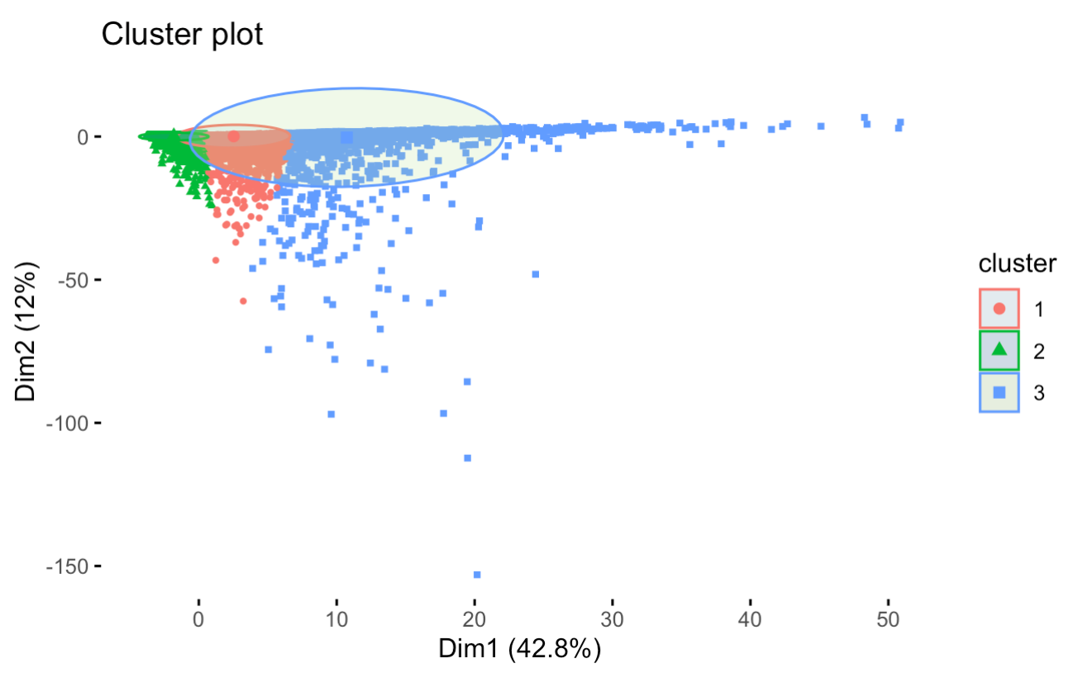
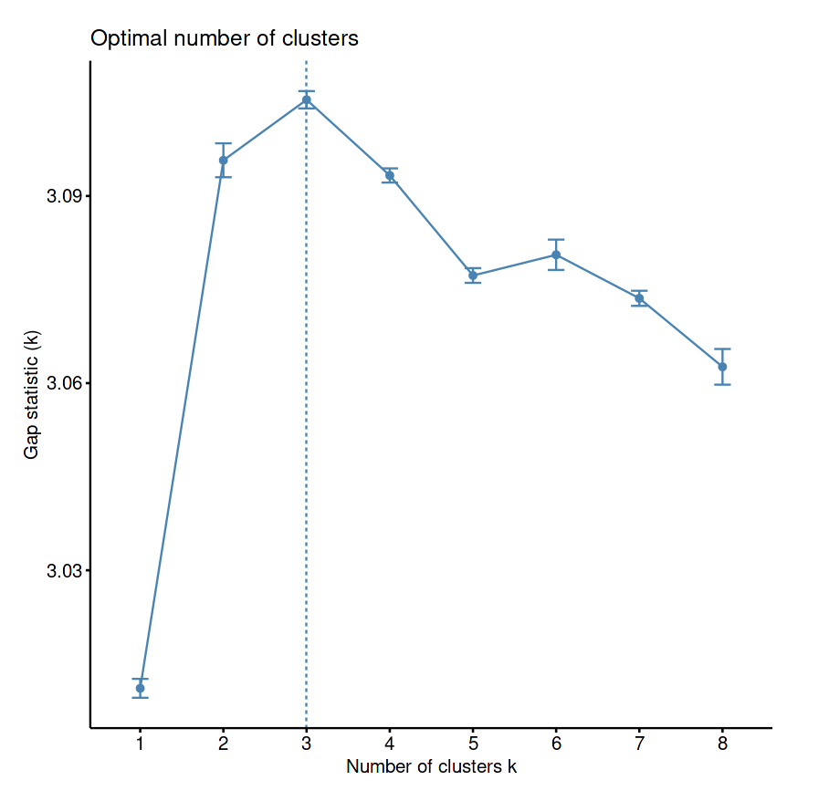
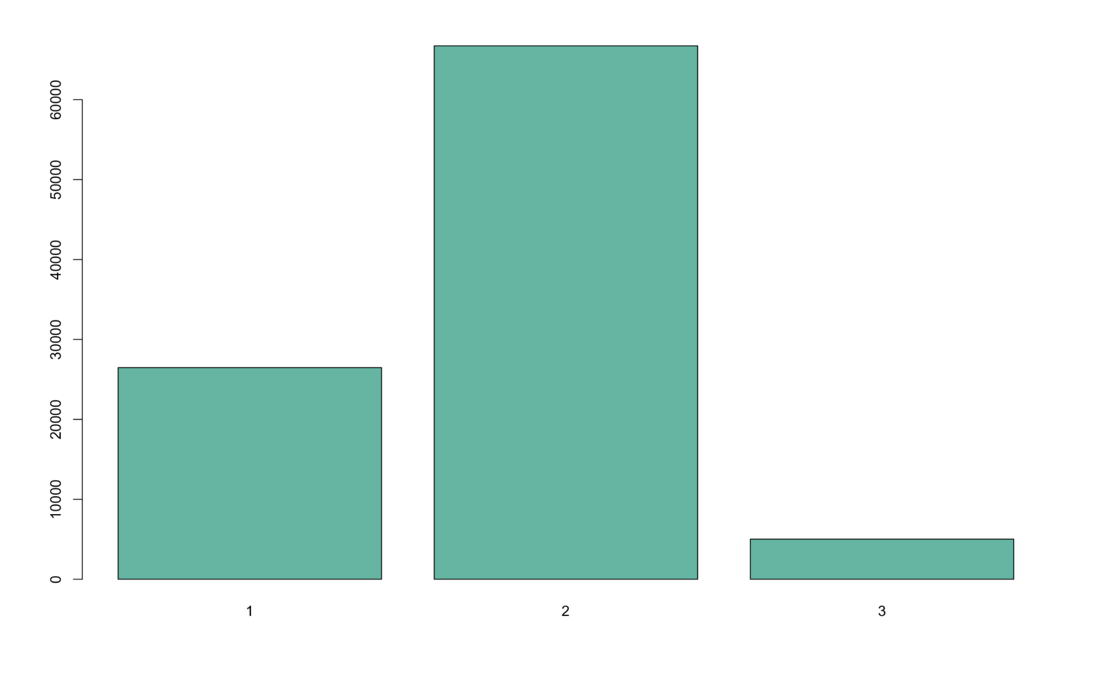
CLUSTERING
The optimal number of clusters is three
One group can correspond to customers that left the company and other to the ones that remain
Cluster three are the most extreme customers and second the most common
Notes:
Let's see if now with our previous hypothesis we can group the customers in the ones that left and the ones that did not leave.
First of all, let's see whats is the optimal number of clusters. At first, We just print a couple of graphs and After looking at each portion of the data set, it looks like they are fairly similar and that the optimal number of cluster could be around 3,4 or 5. And then we used a simple bostrapping to find the the best number is 3 so that is what we are going to use.
----------------------
At first we tried normal k-means, when graph the number of occurrences for each cluster, Here we see that there is a group with most of the customers, and other not so big. However, the third group is almost ineligible. The hypothesis could be as the one we had before. One group can correspond to customers that left the company and other to the ones that remain.
When plotting the clusters, Here we can see that the most populated cluster (cluster 2) is at the right foremost part, followed by the first cluster and finally the third. This shows that number 3 are the most extreme customers and 2 the most common, that’s also confirm that each cluster correspond to the customer those leave or not.
We also tried Mahalanobis distance K-Means distance k mean and got similar reseluts but not shown here. And also several other

Slide 16
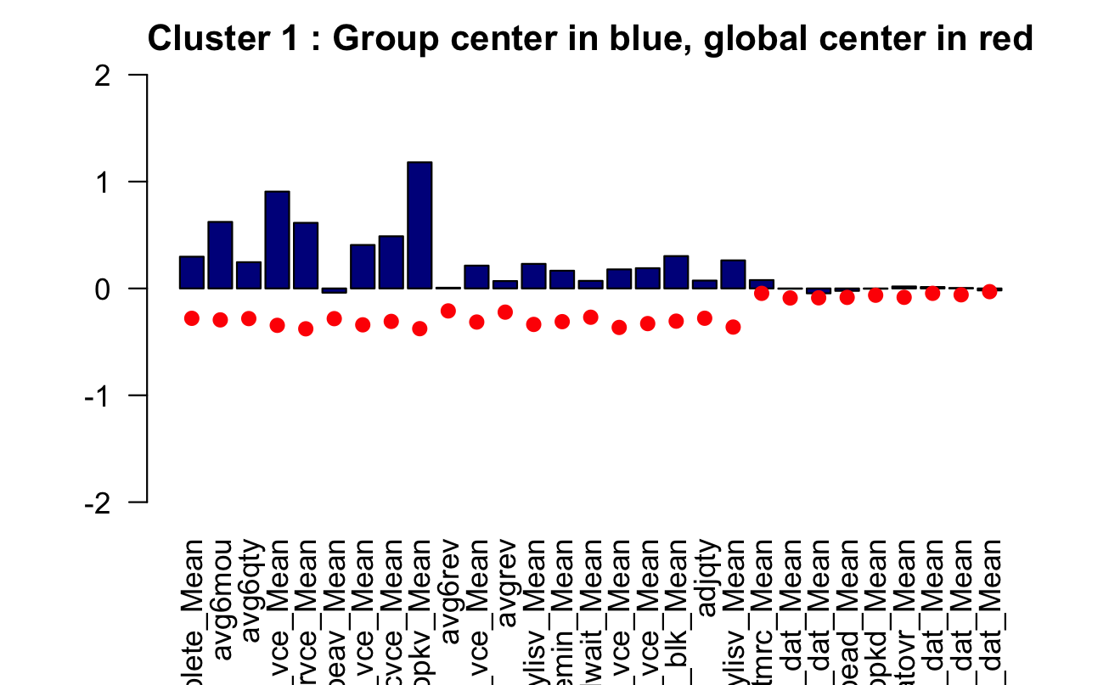
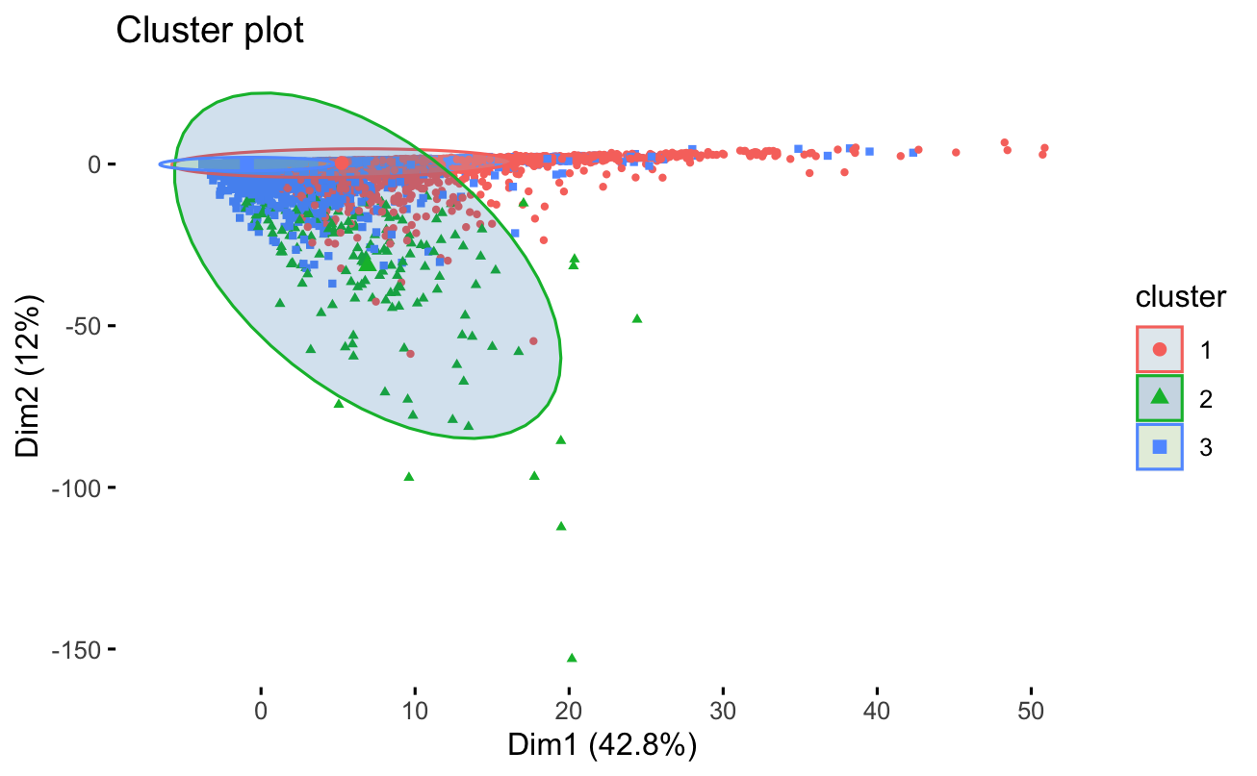
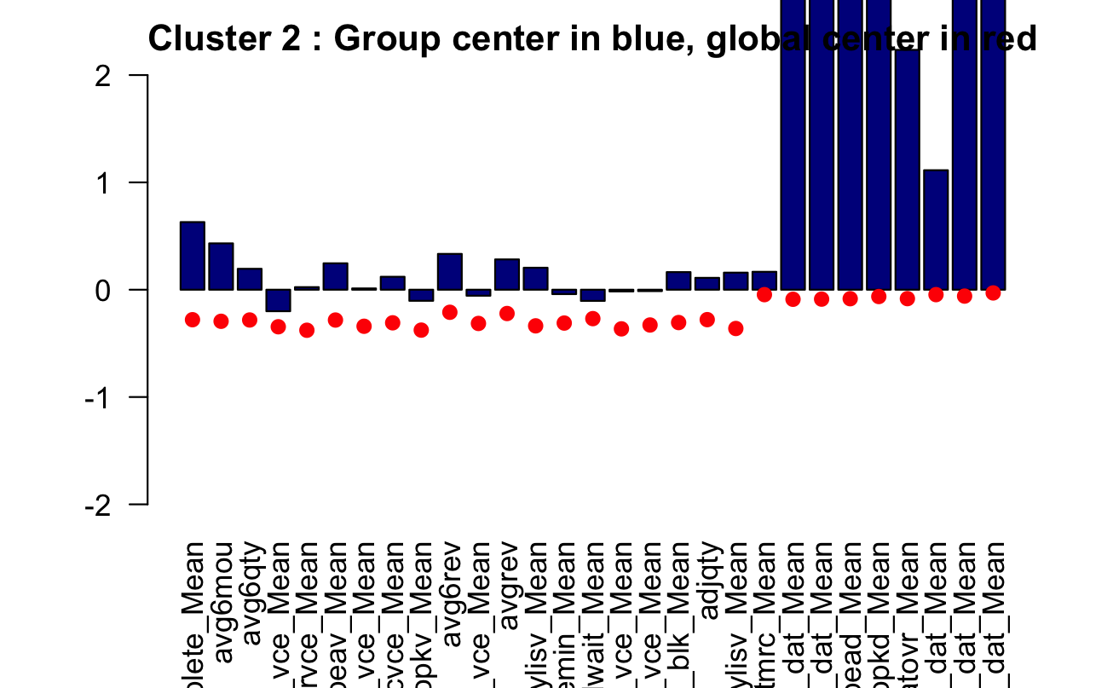
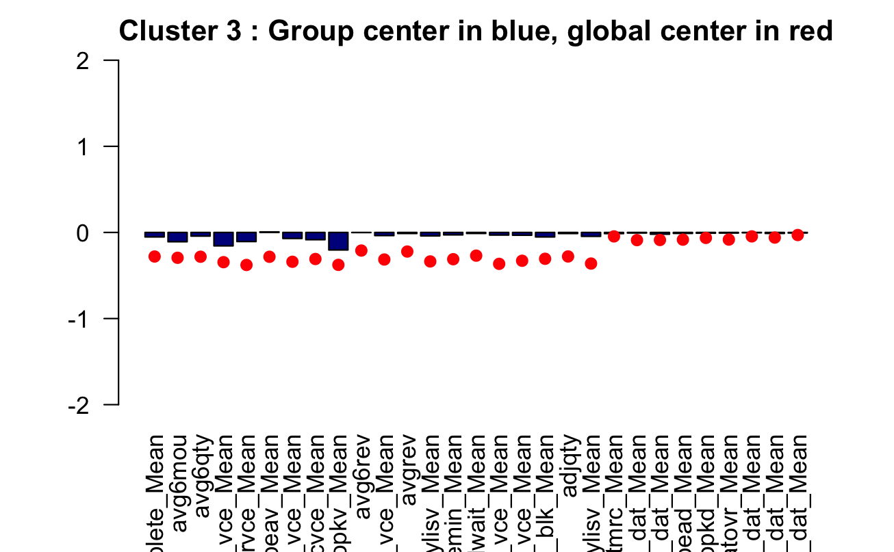
Mahalanobis distance K-Means

Slide 17
CLUSTERING
Kernel K-Means
Due to the large data set, cannot be performed well
Hierarchical Clustering
Constitutionally expensive for a data set for so many entries
Dendrogram is not the best idea for classification for our data
EM Clustering
Due to the large data set, cannot be performed well
Notes:
in the graph we can see that the best number is 3 to 4.
If we group all the conclusions we know that the best number of clusters is 3, so that is what we are going to use.
Also we have to scale all the data as we explained earlier to get more variate readings as we did before
Let's start with a normal kmeans and se the clusters that it makes.

Slide 18
SUPERVISED LEARNING

Slide 19
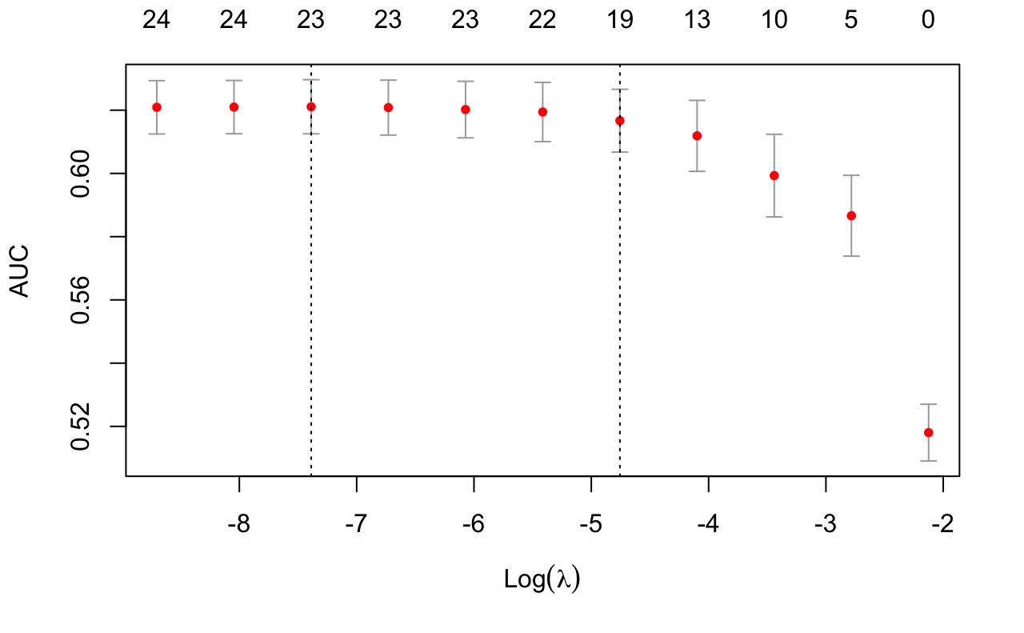
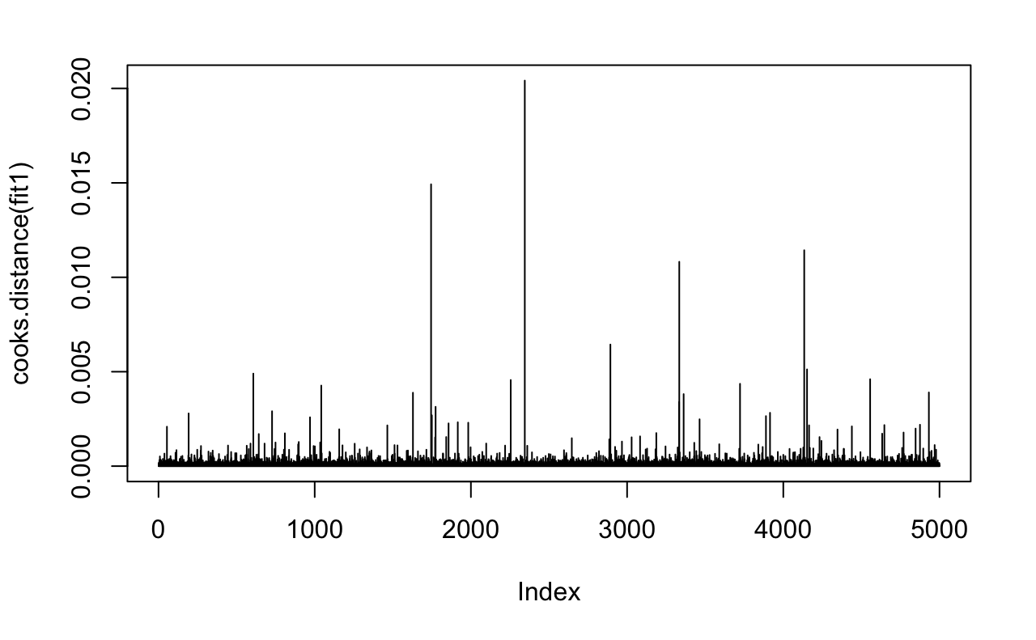
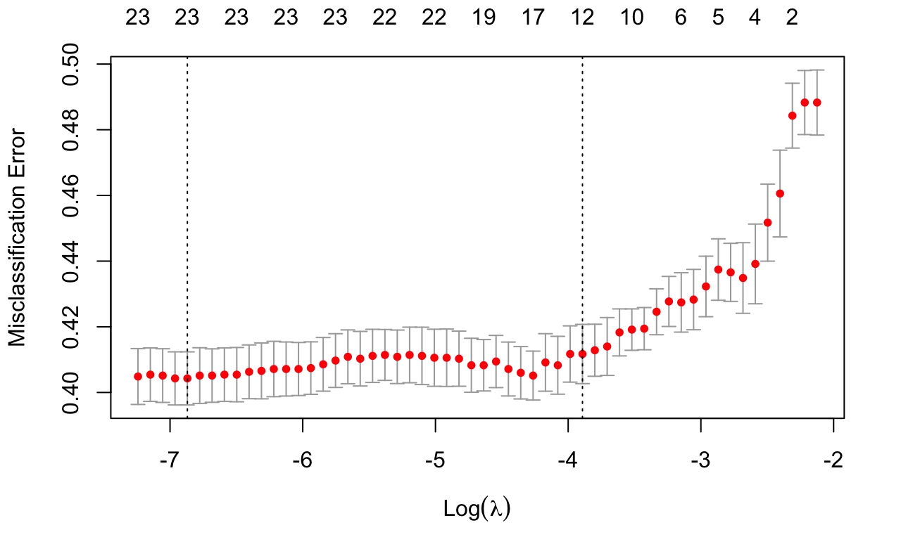
LOGISTIC REGRESSION
Backward elimination in additive model
Residual Analysis: Leverages and outliers
10-fold cross validation to minimize the penalty
Reconstructed a new logistic model with the smallest penalty for classification model evaluation
Notes:
The frequency of the response variables is around 0.5, thus we did not balance the data

Slide 20
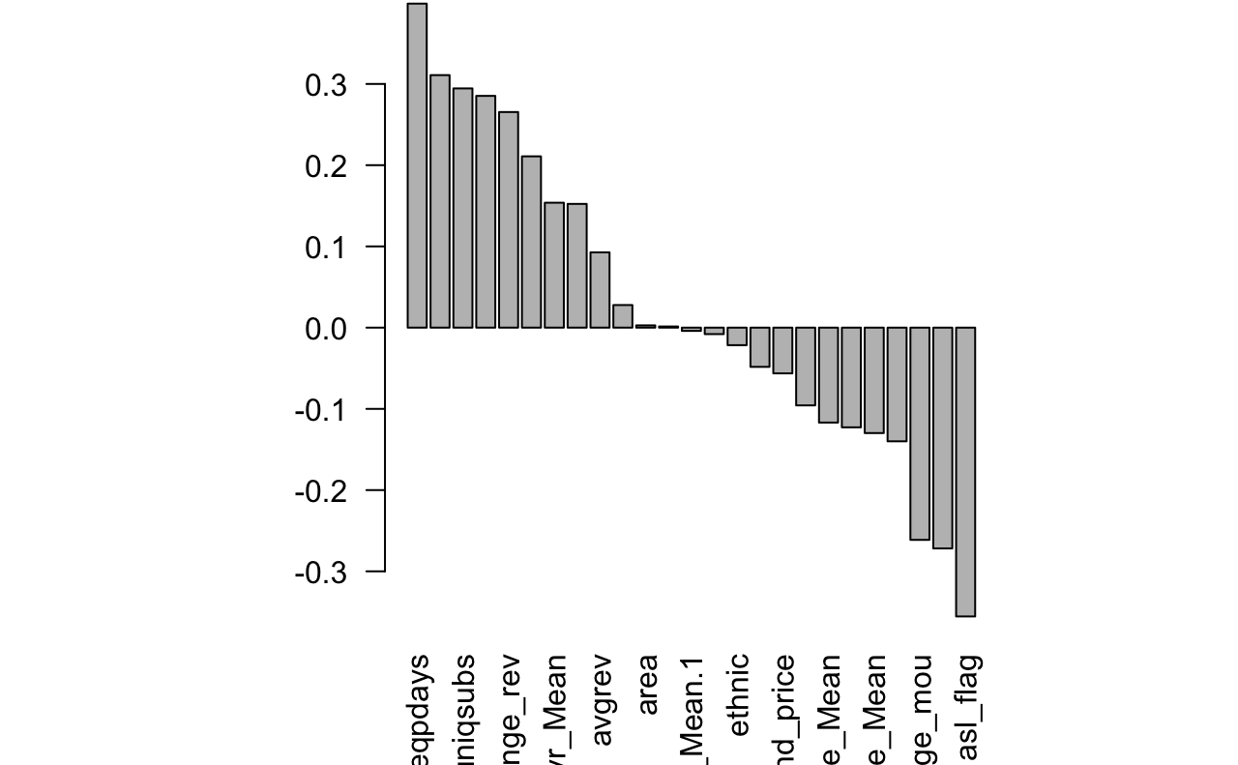
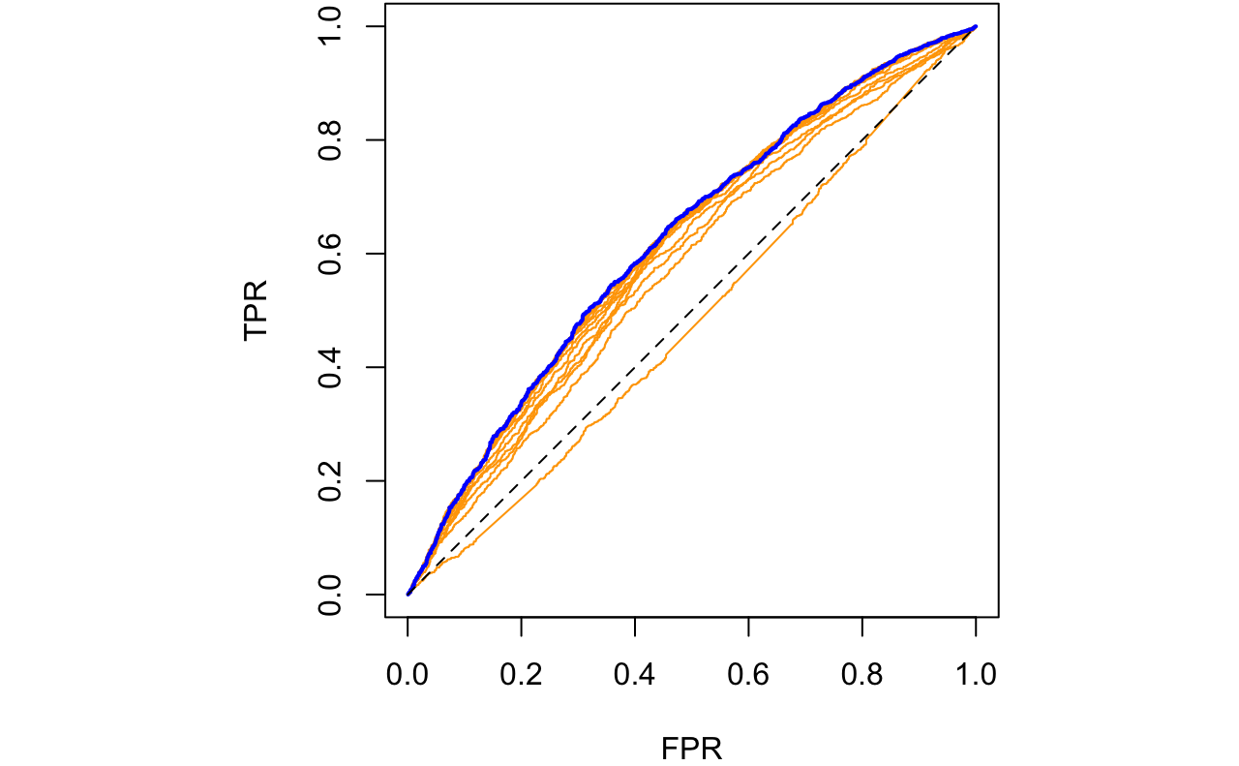
LOGISTIC REGRESSION
Coefficients
ROC Curves

Slide 21
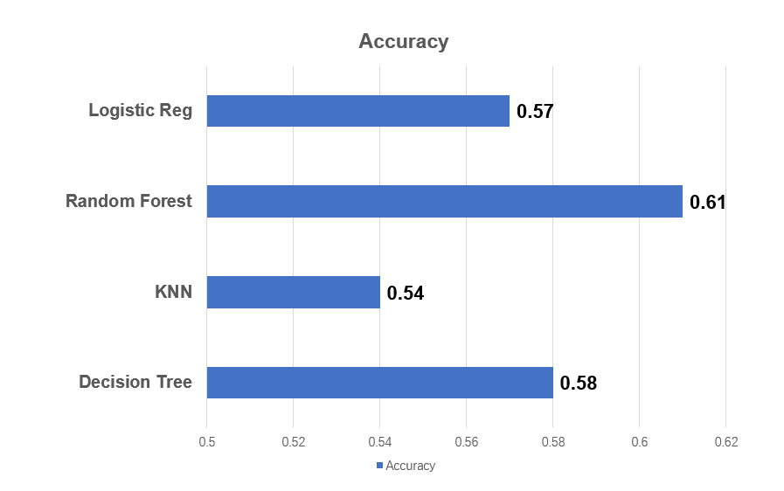
MODEL COMPARISONS IN R
The random forest model performs the best, with 61 percent accuracy.
The accuracy of each model is over 50 percent.
Helps to predict whether a telecom company will retain a designated customer.

Slide 22
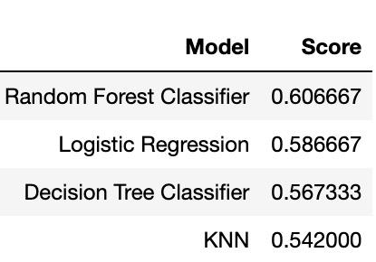
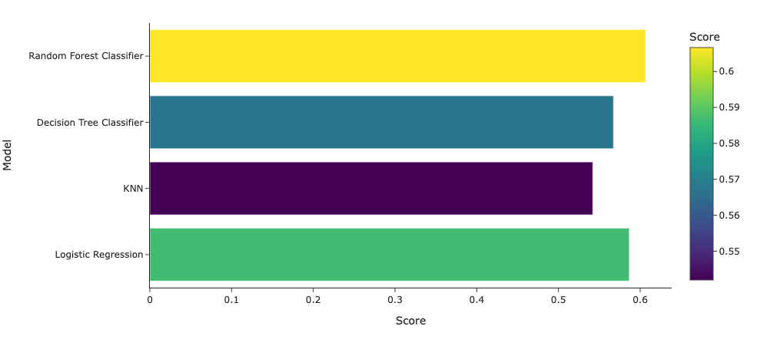
MODEL COMPARISONS WITH PYTHON

Slide 23
CONCLUSION & DISCUSSION

Slide 24
CONCLUSION
All variables are grouped into two clusters, and one can correspond to customers that left the company and other to the ones that remain
The random forest model has the best performance, according to its highest accuracy rate. However, the logistic model has better interpretations on associations among the selected variables.

Slide 25
RECOMMENDATION
Diagnostic analysis on leverages and outliers
Transformations on numerical variables instead of simple scaling

Slide 26
THANK YOU
INSTRUCTOR：Dr. Ruoqing Zhu
GROUP MEMBERS: Xiaoying Yang, Bo Yang, Yin Tip Ho

